Slide 1
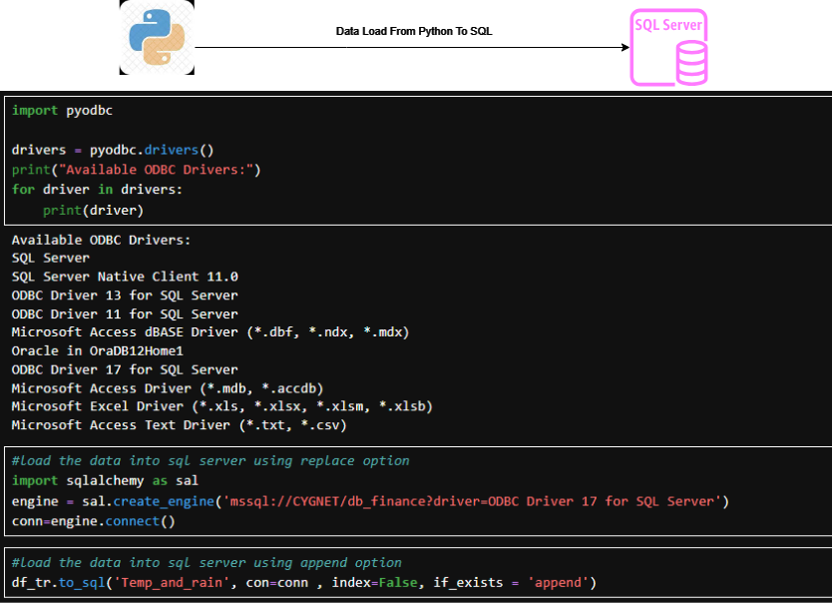
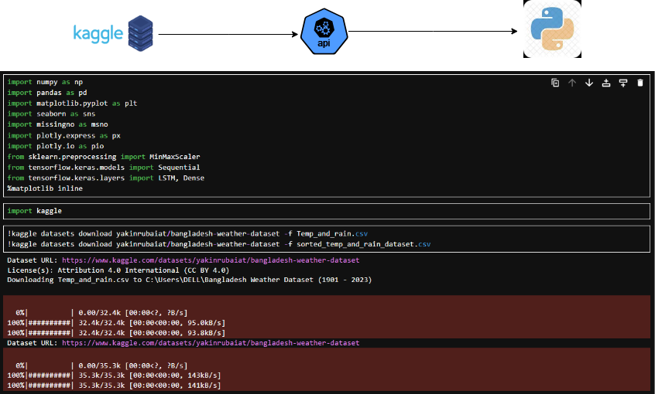
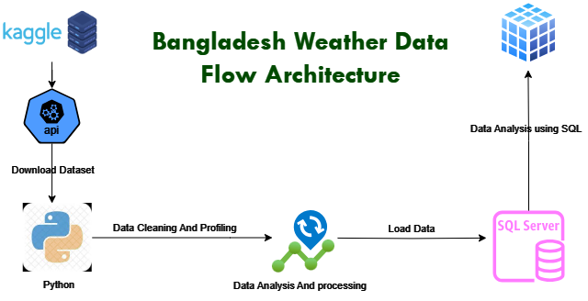
C
Bangladesh
B
A
Weather Data Analysis 1901-2023
Abu Md. Tariqul Ismail
www.tariqulismai.com

Slide 2



Analysis Of Rain from 1901 - 2023

Slide 3



Analysis Of Temperature from 1901 - 2023

